Slide 1

FACE EMOTION DETECTION
Submitted to:- Mr.Ashwini Kumar
Submitted by:- Deepshi Jindal
Roll No:- 58
University Roll No.:- 2016723

Slide 2
1. Introduction 2. Problem Statement 3. Methodology 4. Emotion Detection Model 5. Result and Discussion 6. Conclusion 7. Future Work
INDEX

Slide 3
Emotions are an essential aspect of human communication, enabling us to convey and understand complex feelings. Accurately recognizing and interpreting emotions can provide valuable insights across various fields. In this project, we aim to leverage computer vision and machine learning techniques to develop a robust system for detecting and classifying facial expressions, allowing us to identify the emotions expressed by individuals with high accuracy. By analyzing facial features and patterns, our objective is to create an accurate and reliable emotion detection system. Throughout this project, we will prioritize ethical considerations surrounding face emotion detection. Privacy and consent will be paramount, ensuring that our system operates within appropriate boundaries and respects individual rights. By addressing these ethical concerns, we aim to develop a practical and efficient face emotion detection system that upholds the values of fairness, transparency, and respect. Facial emotion detection system is one of the main applications of machine vision that widely attended in recent years. It serves as a socially intelligent software tool.
Introduction

Slide 4
Accurately recognizing and interpreting emotions from facial expressions is a challenging task with significant implications in various fields. In this project, our goal is to develop a robust system for detecting and classifying facial expressions, enabling us to identify the emotions expressed by individuals accurately. We will leverage computer vision and machine learning techniques to analyze facial features and patterns, ultimately creating an accurate and reliable emotion detection system. The challenges faced in this project are multifaceted. Firstly, extracting relevant facial features and capturing subtle changes in facial expressions pose a significant technical hurdle. We must explore and employ advanced techniques in facial feature extraction, considering factors such as variations in lighting conditions, head poses, and individual differences. Secondly, accurately classifying emotions from facial expressions is a complex task due to the inherent subjectivity and contextual dependencies of human emotions. We will need to train our machine learning models using diverse datasets that encompass a wide range of individuals, cultures, and contexts. This will enable our system to generalize well and accurately classify emotions such as happiness, sadness, anger, surprise, fear, and disgust across various scenarios.
Problem Statement

Slide 5
We have essentially used Convolutional Neural Networks for the detection of various emotions. The pipeline prepared for the entire project can be divided into two phases namely - Dataset Training and Implementation of Emotion Detection model. Dataset Training For efficient detection of emotion in real-time, it is important to have a model trained specifically on various emotion images for proper feature extraction and classification of a specific emotion.
Methodology

Slide 6
1. Data Collection – For the training, we have used a FER-2013 Dataset, which consists of 48x48 pixel grayscale images of faces. 2. Image Preprocessing – The images of the dataset are preprocessed to be trained using various specifications such as size and color of the images. The color of the images is set to grayscale for smooth and efficient extraction of the facial features. 3. Designing CNN – Upon successful preprocessing of the dataset images, a Convolutional Neural Network is designed since CNN can be modified and designed to recognize patterns of the face hence evaluation of facial features on various levels is possible 4. Training the CNN – After development of the CNN, it is trained on the specific dataset we had collected in the vert first step, to identify facial expressions at each type if emotion depending upon the constraints specified while designing the CNN. 5. Processing the model – After successful training of the CNN, the trained model is stored in a XML format which contains the weights the model learned while training on the dataset.

Slide 7
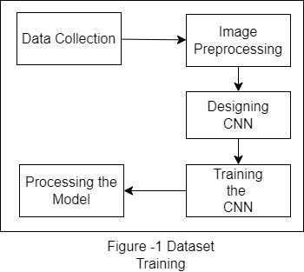
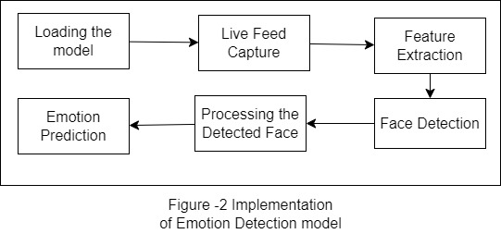
Emotion Detection model

Slide 8
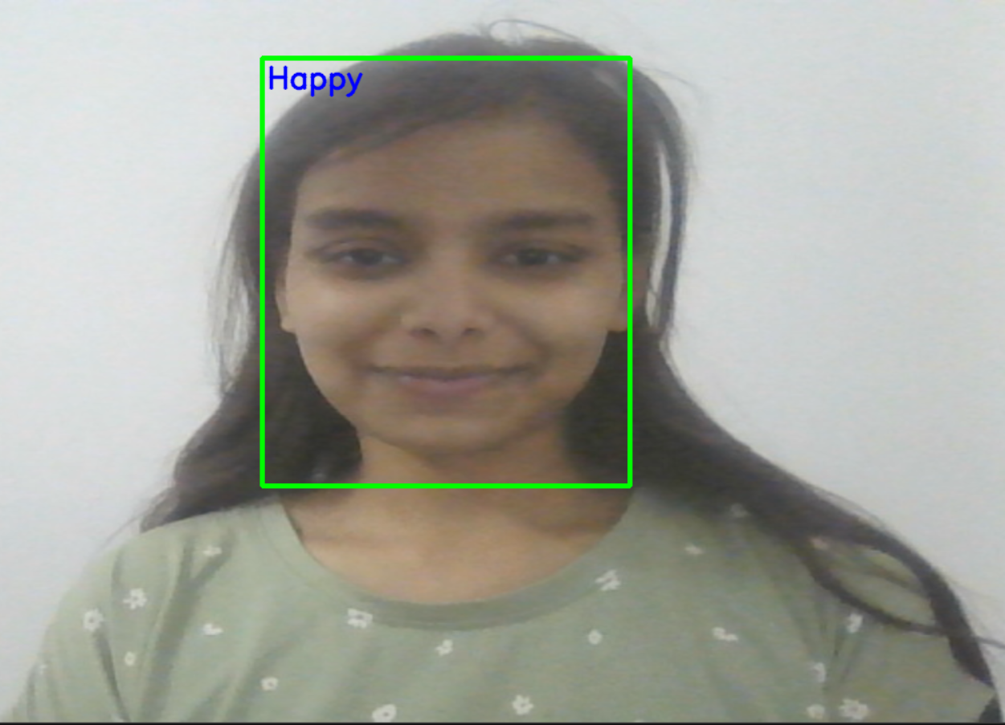
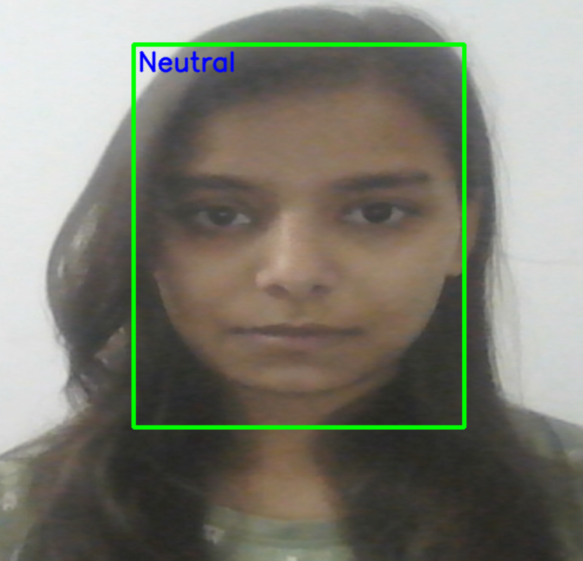
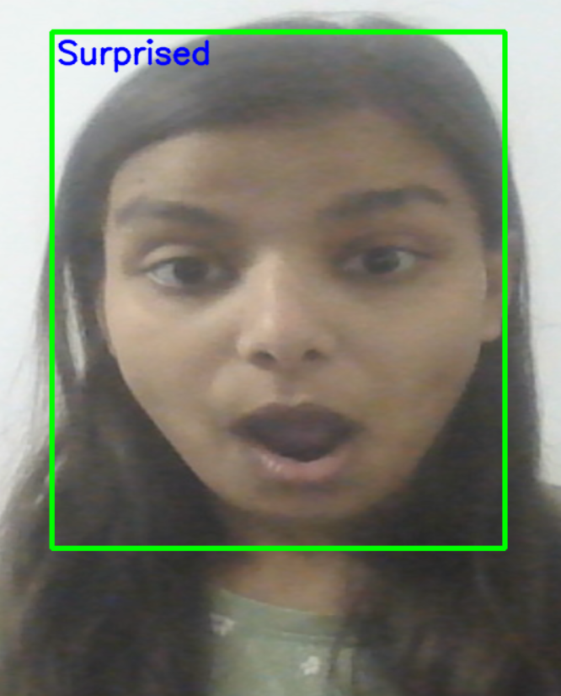
Result and Discussion After running the face prediction algorithm using the model we trained earlier, the following images depict the detected emotions as below:

Slide 9
In conclusion, the utilization of Convolutional Neural Networks (CNNs) for emotion detection presents a powerful and promising tool in understanding and analyzing human emotions. The capabilities of CNNs allow us to unlock new insights into human behavior and develop innovative applications across various domains. However, it is essential to acknowledge and address the challenges and ethical considerations associated with this technology to ensure its responsible and beneficial use. CNN-based emotion detection systems have shown remarkable potential in accurately recognizing and classifying facial expressions, enabling us to gain a deeper understanding of human emotions. These systems have applications in fields such as psychology, marketing, human-computer interaction, and user experience design. They can contribute to more accurate diagnoses and tailored treatments in psychology, provide valuable insights for businesses to enhance customer sentiment analysis, and improve the interaction between humans and technology.
Conclusion

Slide 10
The following considerations have to be made int the future for the current project: 1.The current model is fairly accurate upto 45 percent and hence the model has to trained upon a large dataset with more specific variations. 2. The current model is not able to detect occluded faces, thus the CNN has to trained and modified in order to also incorporate occluded faces for detection of more individuals efficiently 3. Data Augmentation techniques have to be used such as rotation, scaling, and flipping to artificially increase the size and diversity of your training dataset. This can help improve the robustness of the model and reduce overfitting. 4. The model can be further optimized with different architectures and hyperparameter such as the number of layers, filter sizes, and activation functions.
Future Work

